Slide 1
Semantic Specification of Program for Development
Supervised by
Dr. Muhammad Masroor Ali
Professor
Dept. of CSE, BUET
Presented by
Sourav Saha Dip (1505003)
MD. Al Imran (1505100)
Waqar Hassan Khan (1505107)

Slide 2
Overview
For developing a software a requirement list is given
A software developer designs the software using various classes, functions etc.
From this software we can obtain an ontology

Slide 3
Overview
The ontology is then matched with the requirement list and a mapping between these two is created
We determine quality measurements such as consistency, completeness, correctness, unambiguity
The aim of this research is to improve these measurement values using semantic analysis

Slide 4
Current Approach
Stakeholder provides the software developer with his software requirements
This requirements are incrementally changed throughout the development cycle
The finished product is then evaluated by a series of software testing

Slide 5
Problem in Current Approach
Matching between requirement list and finished software is not automated
Testing a large scale software requires a lot of time and manpower
No universal standard for mapping requirement list to the software

Slide 6
Proposed Approach
Build an ontology from the software using a parser
Mapping the ontology with the given requirement list
Measuring quality parameters such as²:
Consistency
Completeness
Correctness

Slide 7
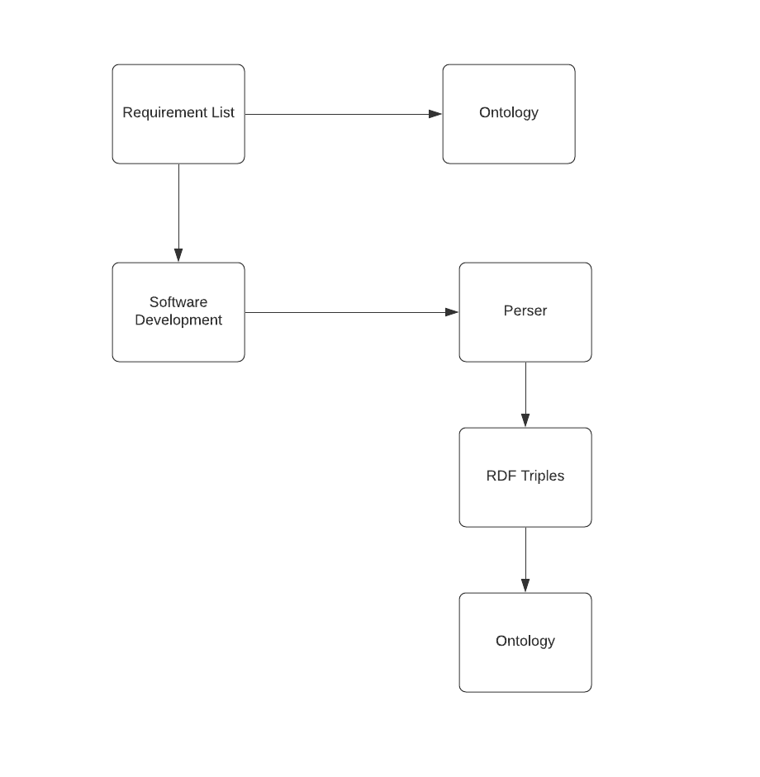
Proposed Approach(contd.)

Slide 8
Proposed Approach(contd.)
Ontology
A formal representation of an object oriented programming language
Classification of the existing concepts
Helps to visualize concepts and relations of a software

Slide 9
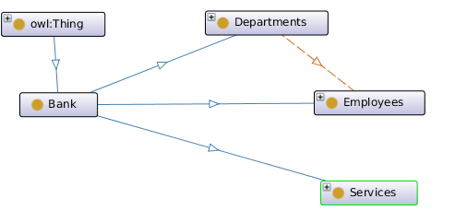
Proposed Approach(contd.)
Fig: Example of Bank Ontology

Slide 10
Proposed Approach(contd.)
Requirement list
A list of itemized sentences written in natural language
Each sentence represents a customers requirement to a software system to be developed
A relationship between a concept from the requirement list and a concept from the ontology

Slide 11
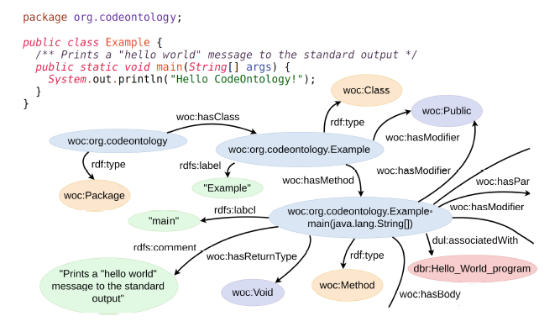
Proposed Approach(contd.)
Creating RDF triples

Slide 12
Software Requirements
CodeOntology
A parser to make rdf triples from java source code and jar files.
Protege
A software to build and visualize ontology using ontograph.

Slide 13
Related Theories
Concepts – In class diagram notation a concept is a node
Function
Object
Constraint
Quality
Relationship – In class diagram notation a relationship is an arc between two concepts
Synonym
Antonym
Contradict
Apply

Slide 14
Related Theories
Example of concepts:
function(play)
object(music)
Example of relationship:
apply(delete, file)
require(player, codec)

Slide 15
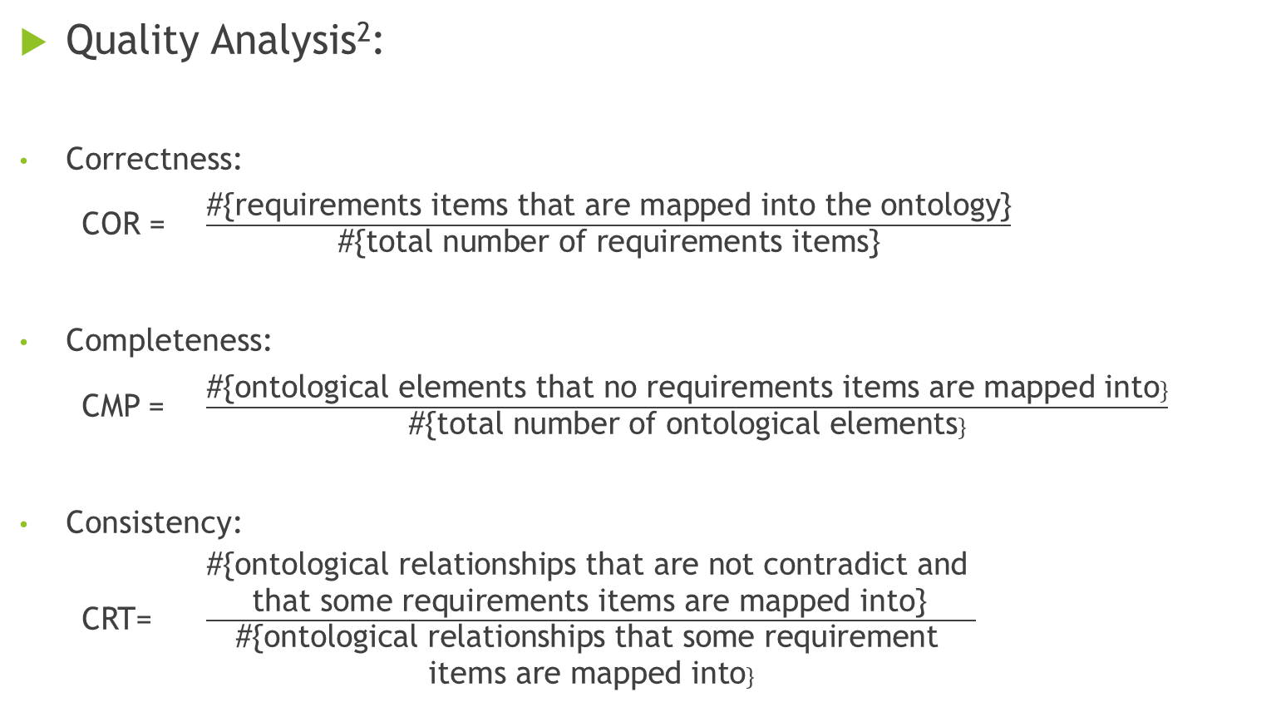
Related Theories
Quality Analysis²:
Correctness:
COR = $\frac{\text{\#\{}\text{requirements} \text{items} \text{that} \text{are} \text{mapped} \text{into} \text{the} \text{ontology}\text{\}}}{\text{\#\{}\text{total} \text{number} \text{of} \text{requirements} \text{items}\text{\}}}$
Completeness:
CMP = $\frac{\text{\#\{}\text{ontological} \text{elements} \text{that} \text{no} \text{requirements} \text{items} \text{are} \text{mapped} \text{into}\}}{\text{\#\{}\text{total} \text{number} \text{of} \text{ontological} \text{elements}\}}$
Consistency:
CRT= $\frac{\begin{aligned}\text{\#\{}\text{ontological} \text{relationships} \text{that} \text{are} \text{not} \text{contradict} \text{and} \\ \text{that} \text{some} \text{requirements} \text{items} \text{are} \text{mapped} \text{into}\text{\}} \end{aligned}}{\begin{aligned}\text{\#\{}\text{ontological} \text{relationships} \text{that} \text{some} \text{requirement} \\ \text{items} \text{are} \text{mapped} \text{into}\}\end{aligned}}$

Slide 16
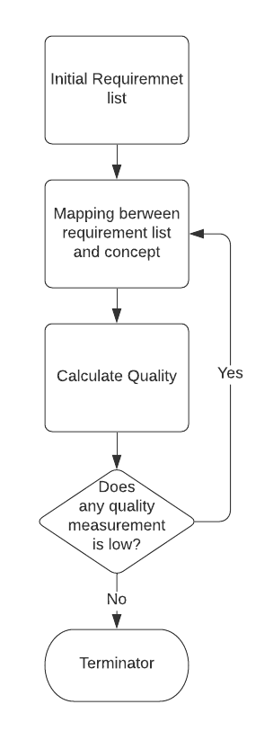
Related Theories
Fig: Procedure for requirements elicitation

Slide 17
Related Theories
Update the requirement list
When completeness is low, find and add new item to the requirement list
When correctness is low, ask stakeholder if the items are really necessary or not of the incorrect items in the requirement list
When consistency measure is low, one of two inconsistent items is selected to be removed

Slide 18
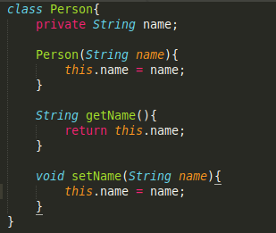
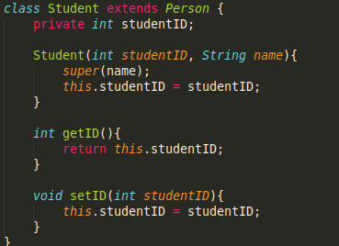
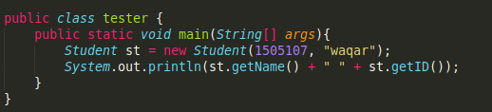
Implementation
Using the Codeontology parser to make rdf from source code

Slide 19
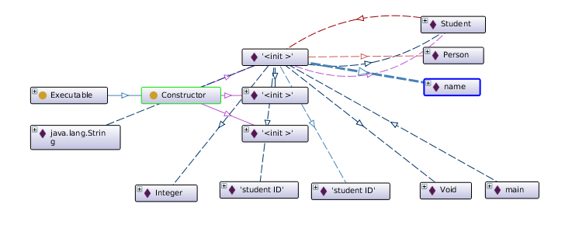
Implementation
Fig. Ontograph of the source code

Slide 20
Implementation
BUET undergrad admission system software
Requirement specifications have been given in a prospectus
An ontological representation of the software has been built by the software developer
Authority can check whether the software is correct or not
Map the requirement list with the ontology
Measure quality parameters of this mapping

Slide 21
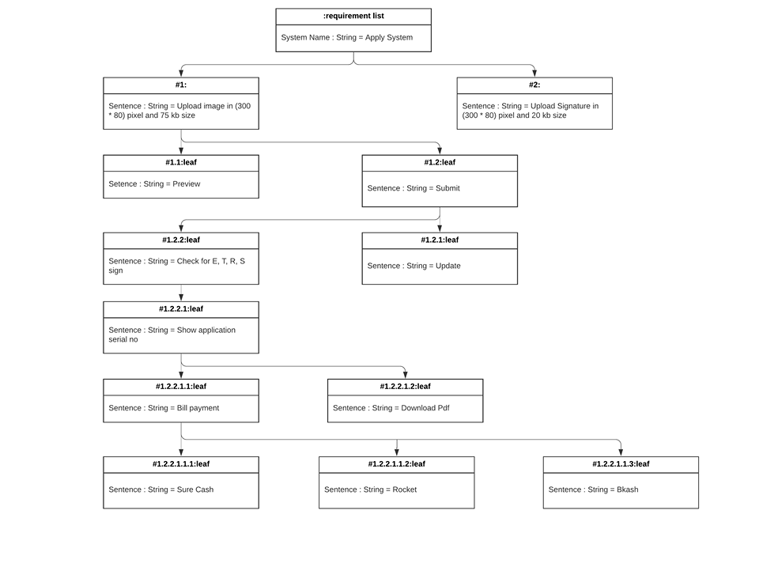
Implementation
Fig: Undergrad Admission System Requirement List

Slide 22
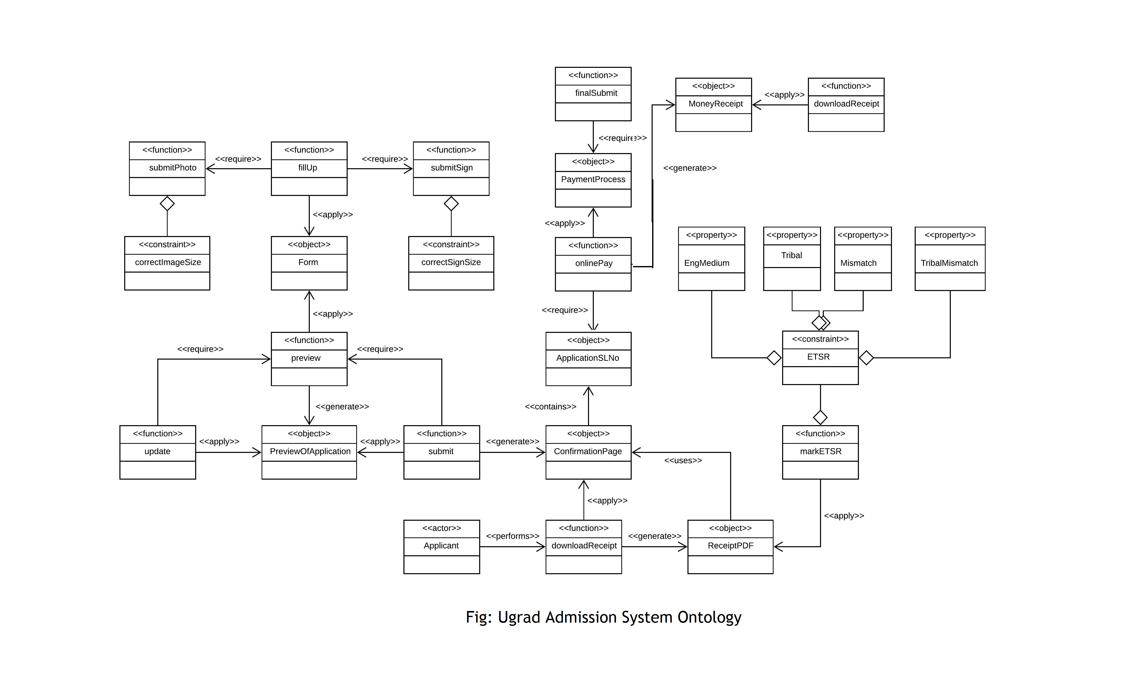

Slide 23

Implementation
Quality measurement:
Correctness:
COR = $\frac{\begin{aligned}\text{\#\{}\text{requirements} \text{items} \text{that} \text{are} \text{mapped} \\ \text{into} \text{the} \text{ontology}\text{\}}\end{aligned}}{\text{\#\{}\text{total} \text{number} \text{of} \text{requirements} \text{items}\text{\}}}$
= $\frac{9}{12}$
= 75%

Slide 24
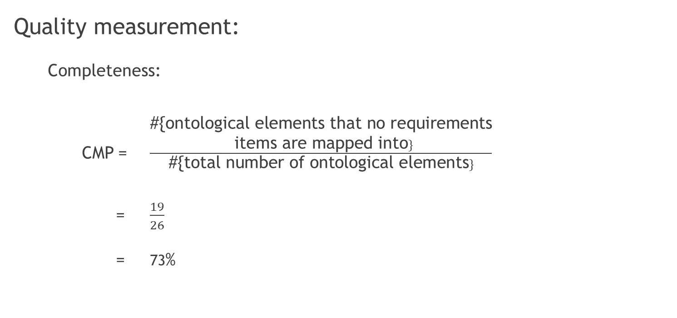
Implementation
Quality measurement:
Completeness:
CMP = $\frac{\begin{aligned}\text{\#\{}\text{ontological} \text{elements} \text{that} \text{no} \text{requirements} \\ \text{items} \text{are} \text{mapped} \text{into}\}\end{aligned}}{\text{\#\{}\text{total} \text{number} \text{of} \text{ontological} \text{elements}\}}$
= $\frac{19}{26}$
= 73%

Slide 25
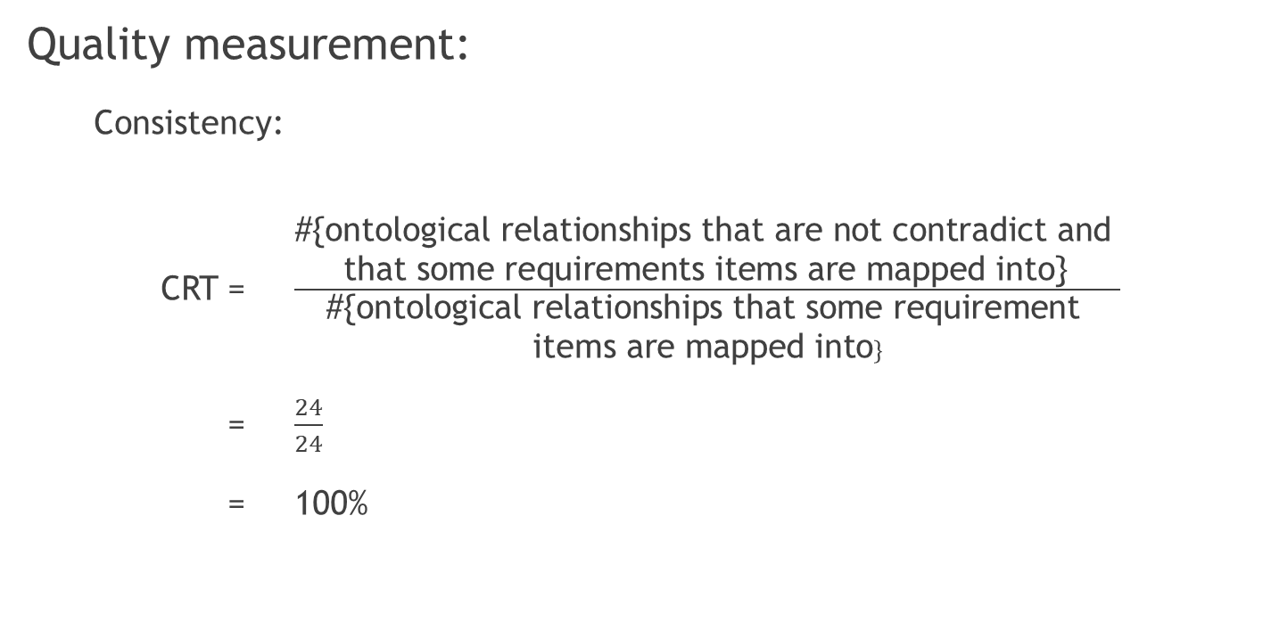
Implementation
Quality measurement:
Consistency:
CRT = $\frac{\begin{aligned}\text{\#\{}\text{ontological} \text{relationships} \text{that} \text{are} \text{not} \text{contradict} \text{and} \\ \text{that} \text{some} \text{requirements} \text{items} \text{are} \text{mapped} \text{into}\text{\}} \end{aligned}}{\begin{aligned}\text{\#\{}\text{ontological} \text{relationships} \text{that} \text{some} \text{requirement} \\ \text{items} \text{are} \text{mapped} \text{into}\}\end{aligned}}$
= $\frac{24}{24}$
= 100%

Slide 26
References
1) https://www.kdnuggets.com/2017/05/ontology-simplest-definition.html
2) Ontology Based Requirements Analysis: Lightweight Semantic Processing Approach- by Haruhiko Kaiya and Motoshi Saeki
3) Using Domain Ontology as Domain Knowledge for Requirements Elicitation
- by Haruhiko Kaiya and Motoshi Saeki
4) CodeOntology: RDF-ization of Source Code – by Mattia Atzeni and Maurizio Atzori
5) Parser - https://github.com/codeontology/parser

